Slide 1
Unit – 5 Memory Management

Slide 2
Memory Management
Background
Swapping
Contiguous Allocation
Paging
Segmentation
Segmentation with Paging

Slide 3
Background
Program must be brought into memory and placed within a process for it to be run
Input queue – collection of processes on the disk that are waiting to be brought into memory to run the program
User programs go through several steps before being run

Slide 4
Binding of Instructions and Data to Memory
Address binding of instructions and data to memory addresses can happen at three different stages
Compile time
Load time
Execution time

Slide 5
Logical vs. Physical Address Space
The concept of a logical address space that is bound to a separate physical address space is central to proper memory management
Logical address – generated by the CPU; also referred to as virtual address
Physical address – address seen by the memory unit
Logical and physical addresses are the same in compile-time and load-time address-binding schemes; logical (virtual) and physical addresses differ in execution-time address-binding scheme

Slide 6
Memory-Management Unit (MMU)
Hardware device that maps virtual to physical address
In MMU scheme, the value in the relocation register is added to every address generated by a user process at the time it is sent to memory
The user program deals with logical addresses; it never sees the real physical addresses

Slide 7
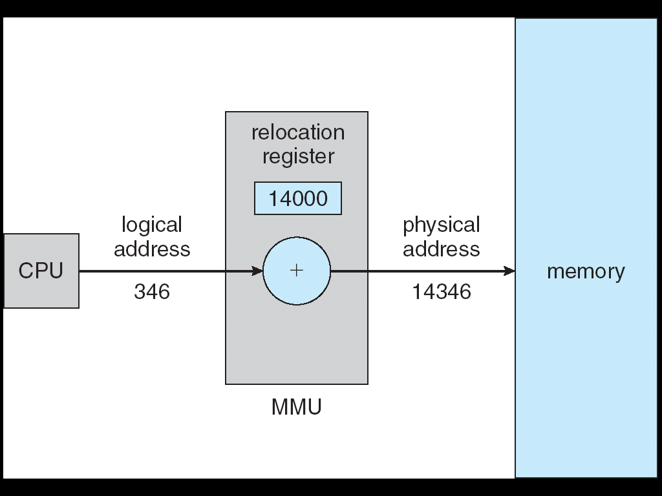
Dynamic relocation using a relocation register

Slide 8
Dynamic Loading
Routine is not loaded until it is called
Better memory-space utilization; unused routine is never loaded
Useful when large amounts of code are needed to handle infrequently occurring cases
No special support from the operating system is required implemented through program design

Slide 9
Swapping
A process can be swapped temporarily out of memory to a backing store, and then brought back into memory for continued execution
Backing store – fast disk large enough to accommodate copies of all memory images for all users; must provide direct access to these memory images
Roll out, roll in – swapping variant used for priority-based scheduling algorithms; lower-priority process is swapped out so higher-priority process can be loaded and executed
Major part of swap time is transfer time; total transfer time is directly proportional to the amount of memory swapped
Modified versions of swapping are found on many systems (i.e., UNIX, Linux, and Windows)

Slide 10
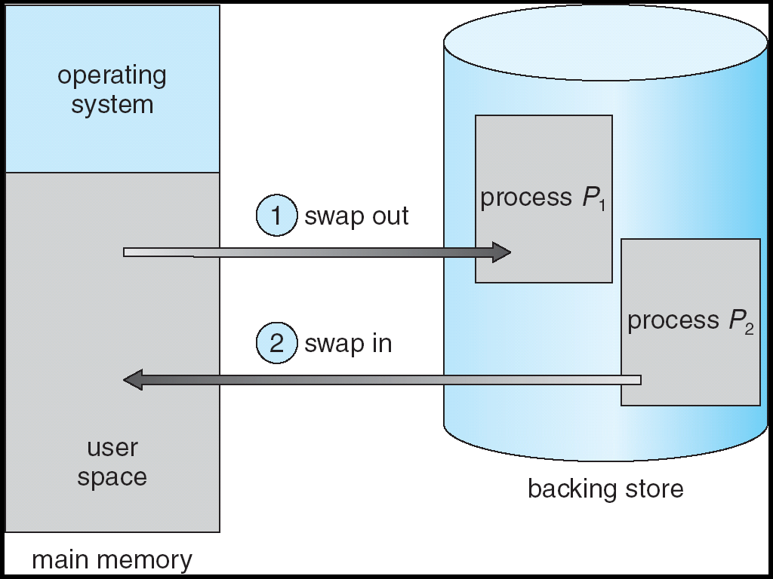
Schematic View of Swapping

Slide 11
Contiguous Allocation
Main memory usually divided into two partitions:
Resident operating system, usually held in low memory with interrupt vector
User processes then held in high memory

Slide 12
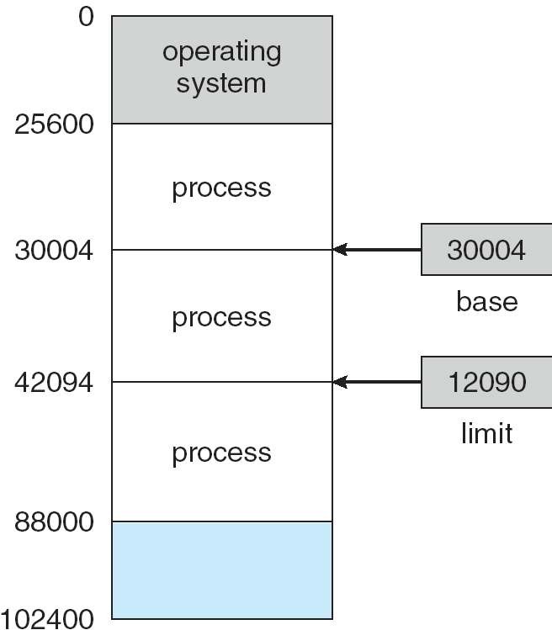
A base and a limit register define a logical address space

Slide 13
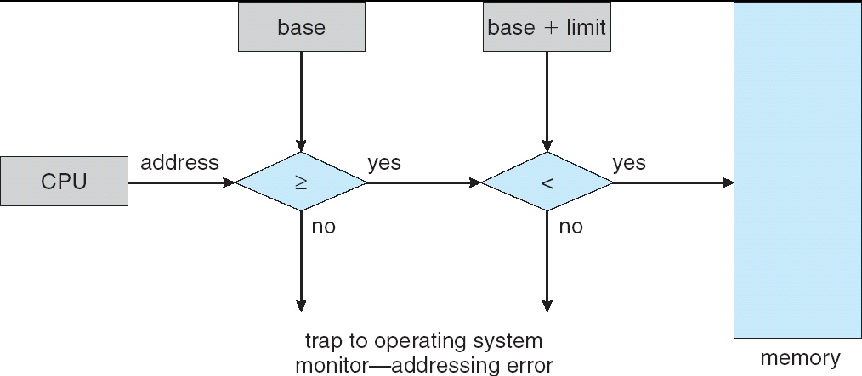
HW address protection with base and limit registers

Slide 14
Contiguous Allocation (Cont.)
Multiple-partition allocation
Hole – block of available memory; holes of various size are scattered throughout memory
When a process arrives, it is allocated memory from a hole large enough to accommodate it
Operating system maintains information about: a) allocated partitions b) free partitions (hole)
OS
OS
OS
OS
process 5
process 5
process 5
process 5
process 9
process 9
process 8
process 10
process 2
process 2
process 2
process 2

Slide 15
Dynamic Storage-Allocation Problem
How to satisfy a request of size n from a list of free holes
First-fit: Allocate the first hole that is big enough
Best-fit: Allocate the smallest hole that is big enough; must search entire list, unless ordered by size. Produces the smallest leftover hole.
Worst-fit: Allocate the largest hole; must also search entire list. Produces the largest leftover hole.
First-fit and best-fit better than worst-fit in terms of speed and storage utilization

Slide 16
Fragmentation
External Fragmentation – total memory space exists to satisfy a request, but it is not contiguous
Internal Fragmentation – allocated memory may be slightly larger than requested memory; this size difference is memory internal to a partition, but not being used
Reduce external fragmentation by compaction
Shuffle memory contents to place all free memory together in one large block

Slide 17
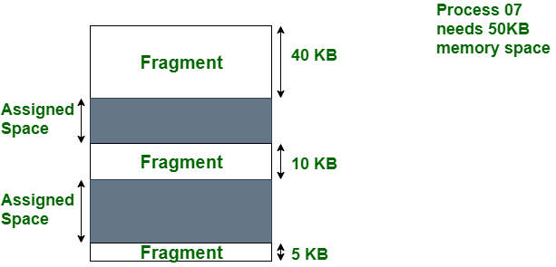
External Fragmentation

Slide 18
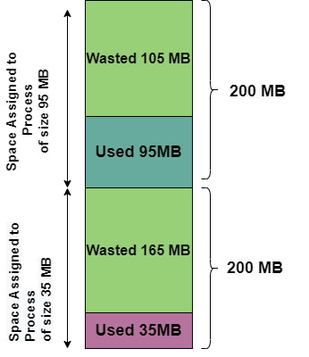
Internal Fragmentation

Slide 19
Paging
Logical address space of a process can be noncontiguous; process is allocated physical memory whenever the latter is available
Divide physical memory into fixed-sized blocks called frames (size is power of 2, between 512 bytes and 8192 bytes)
Divide logical memory into blocks of same size called pages.
Keep track of all free frames
To run a program of size n pages, need to find n free frames and load program
Set up a page table to translate logical to physical addresses
Internal fragmentation

Slide 20
Address Translation Scheme
Address generated by CPU is divided into:
Page number (p) – used as an index into a page table which contains base address of each page in physical memory
Page offset (d) – combined with base address to define the physical memory address that is sent to the memory unit

Slide 21
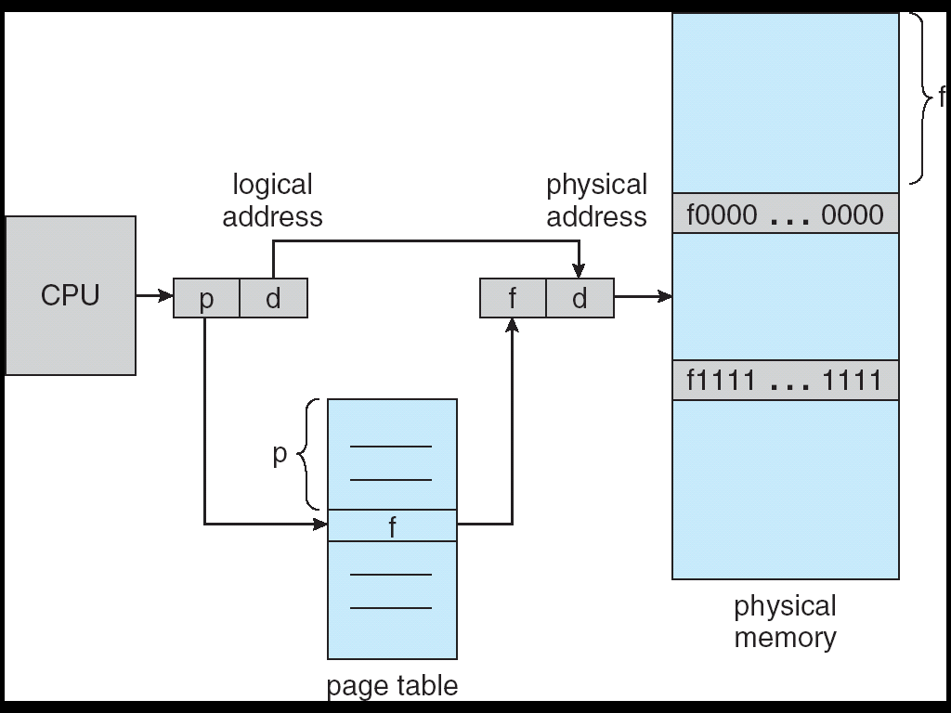
Address Translation Architecture

Slide 22
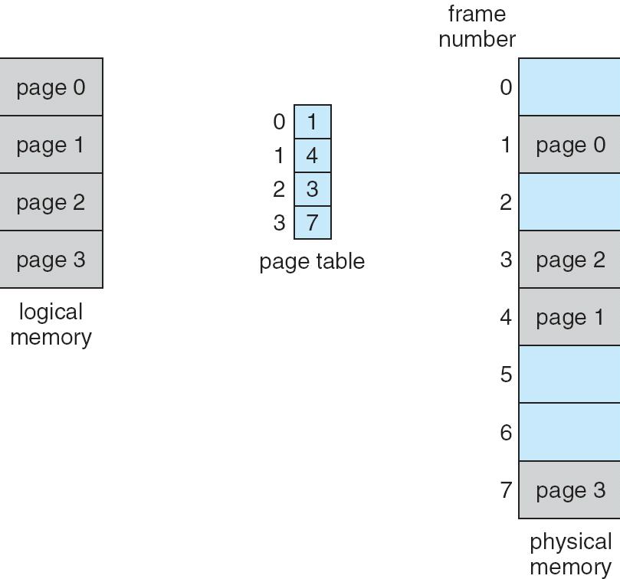
Paging Example

Slide 23
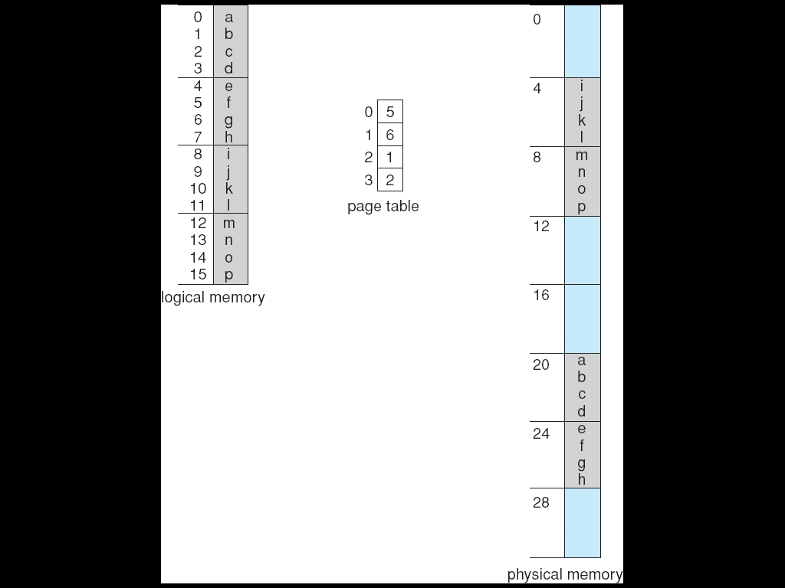
Paging Example

Slide 24
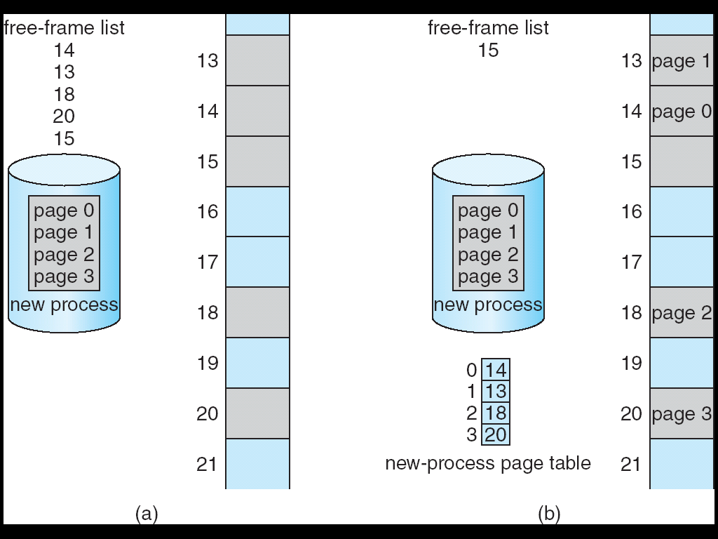
Free Frames
Before allocation
After allocation

Slide 25
Implementation of Page Table
Page table is kept in main memory
Page-table base register (PTBR) points to the page table
Page-table length register indicates size of the page table
In this scheme every data/instruction access requires two memory accesses. One for the page table and one for the data/instruction.
The two memory access problem can be solved by the use of a special fast-lookup hardware cache called associative memory or translation look-aside buffers (TLBs)

Slide 26
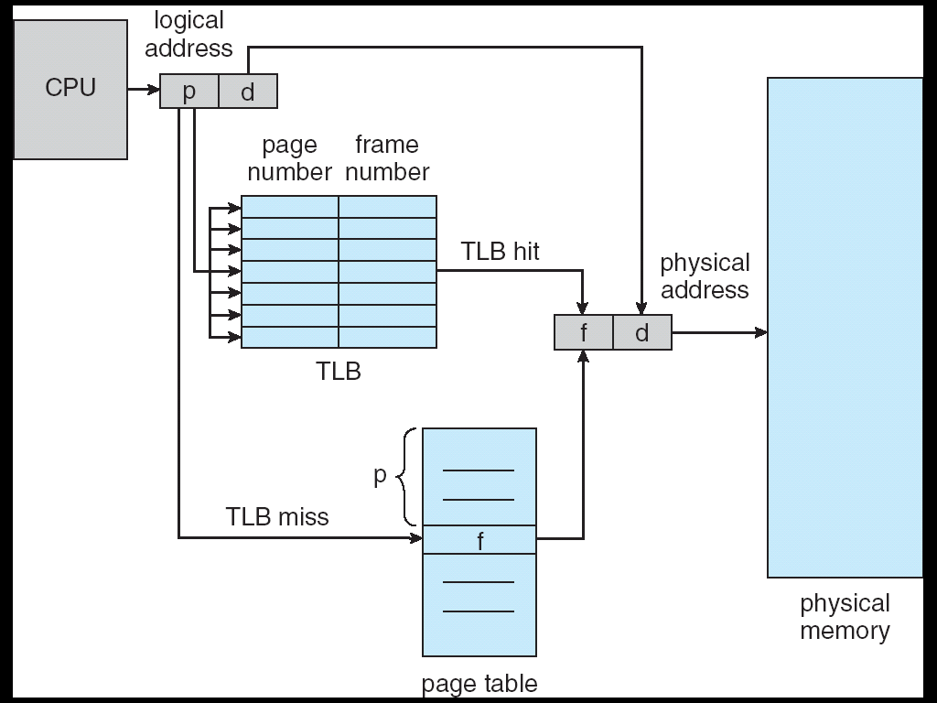
Paging Hardware With TLB

Slide 27
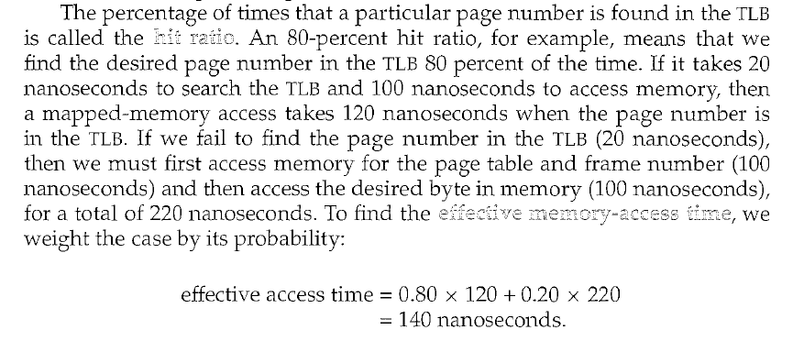

Slide 28
Memory Protection
Memory protection implemented by associating protection bit with each frame
Valid-invalid bit attached to each entry in the page table:
“valid” indicates that the associated page is in the process’ logical address space, and is thus a legal page
“invalid” indicates that the page is not in the process’ logical address space

Slide 29
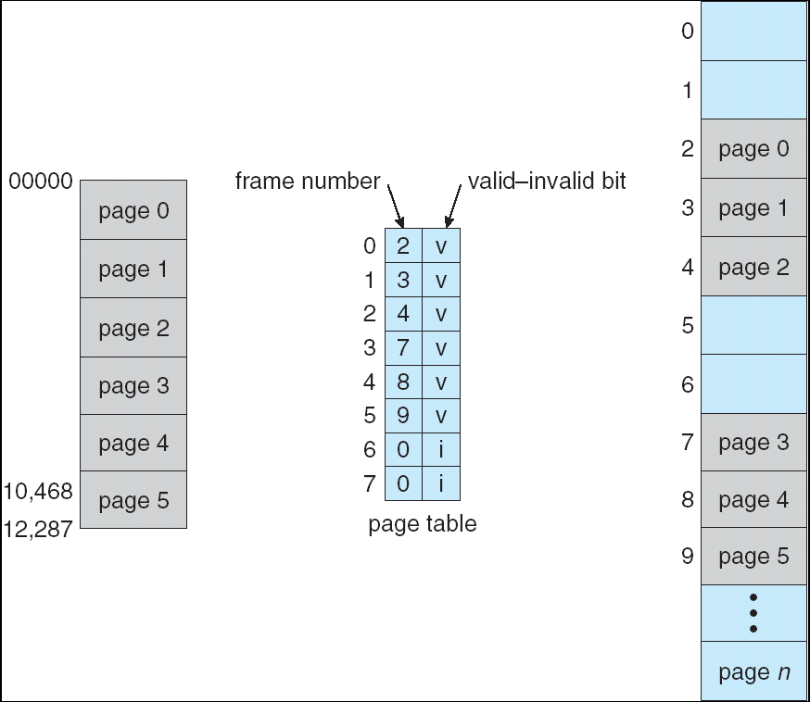
Valid (v) or Invalid (i) Bit In A Page Table

Slide 30
Two-Level Paging Example
A logical address (on 32-bit machine with 4K page size) is divided into:
a page number consisting of 20 bits
a page offset consisting of 12 bits
Since the page table is paged, the page number is further divided into:
a 10-bit page number
a 10-bit page offset
Thus, a logical address is as follows:
where p_{i} is an index into the outer page table, and p₂ is the displacement within the page of the outer page table
page number
page offset
p_{i}
p₂
d
10
10
12

Slide 31
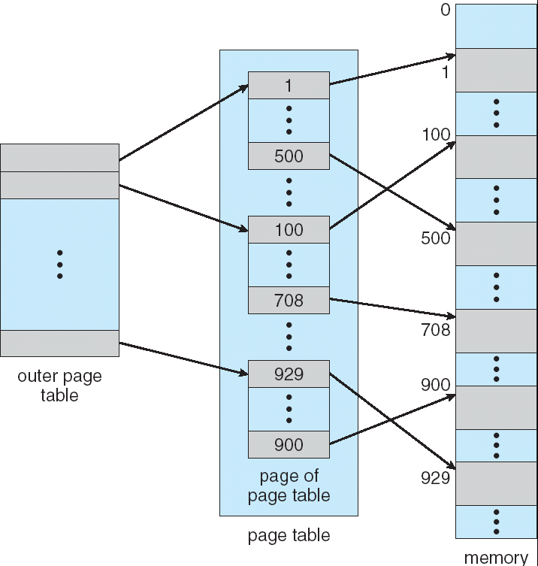
Two-Level Page-Table Scheme

Slide 32
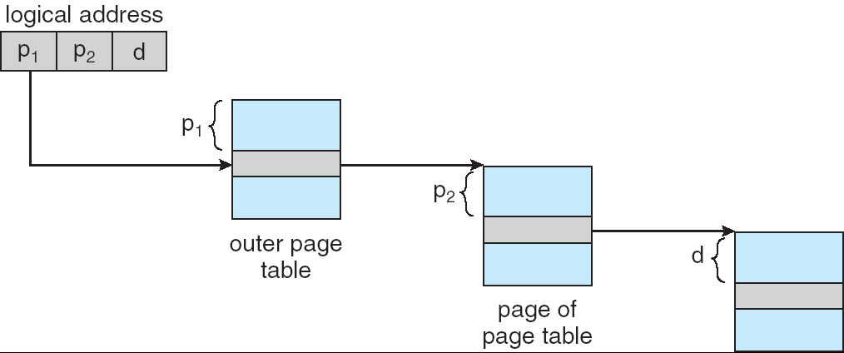
Address-Translation Scheme
Address-translation scheme for a two-level 32-bit paging architecture

Slide 33
Inverted Page Table
One entry for each real page of memory
Entry consists of the virtual address of the page stored in that real memory location, with information about the process that owns that page
Decreases memory needed to store each page table, but increases time needed to search the table when a page reference occurs
Use hash table to limit the search to one — or at most a few — page-table entries

Slide 34
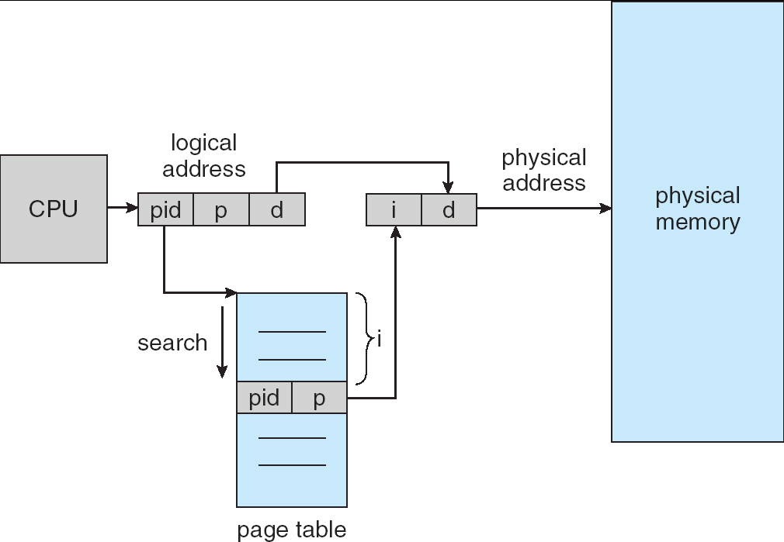
Inverted Page Table Architecture

Slide 35
Segmentation
Memory-management scheme that supports user view of memory
A program is a collection of segments. A segment is a logical unit such as:
main program,
procedure,
function,
method,
object,
local variables, global variables,
common block,
stack,
symbol table, arrays

Slide 36
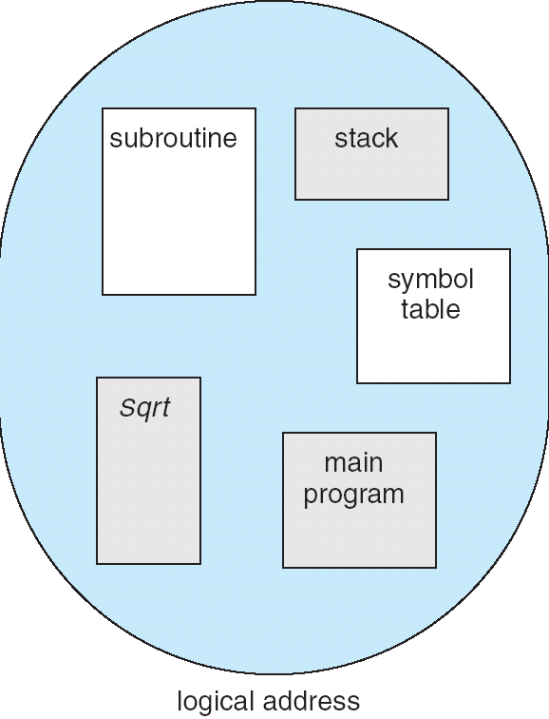
User’s View of a Program

Slide 37
Logical View of Segmentation
1
1
4
2
3
4
2
3
user space
physical memory space

Slide 38
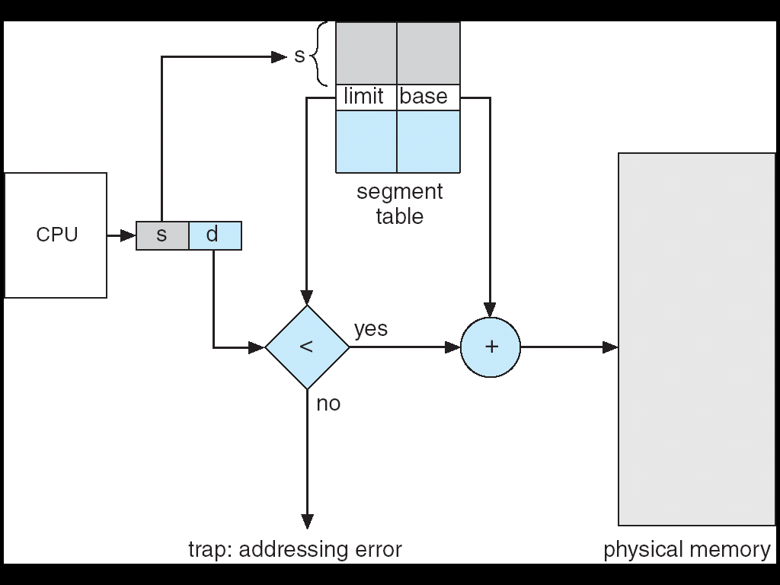
Address Translation Architecture

Slide 39
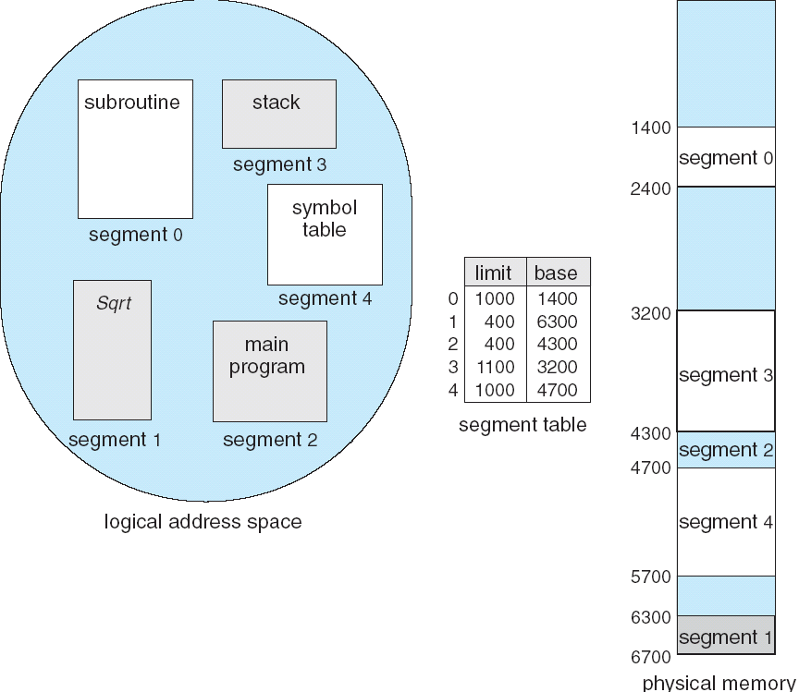
Example of Segmentation

